Slide 1
Gstore Customer Revenue Prediction December 14th, 2018 Author: Amitkumar Advisor: Prof. Can Kavaklioglu Capstone Project (CKME 136)
Notes:
Good evening everyone, I am Amit, today I am going to give a brief overview of my capstone project. I chose gstore customer revenue prediction for my capstone project because of the complexity of data would allow me to apply the concepts that I have learned during the course.

Slide 2
Introduction
Challenge Description and Objective
Methodology Adopted
Model Execution
Conclusion
Tools Used
References
Notes:
We will cover these topics during this presentation
We will be spending most of the time understanding the methodology adopted
And thought process behind selection of tools

Slide 3


Challenge Description and Objective
Notes:
Google has provided the gstore dataset on Kaggle for competition.
This data is in the form of several types i.e Categorical, timeseries, identifiers, missing values, NaN and quantitative
We are required to design a machine learning algorithm that can learn from the given training dataset and can predict revenue for customer behavioral data in test set.
The evaluation metric is RMSE (Root Mean Squared Error)
There were certain challenges related to quality of data which I will explain in methodology

Slide 4
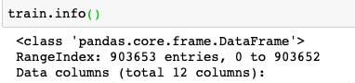
Methodology adopted
1. Initial exploratory data analysis
Notes:
I used python for this challenge
And while exploring I
Noticed that there are approximately 900 thousand observation
There are approximately 700 thousand unique visitors, This indicates there are some visitors with multiple visits (Which is indicated by separate row)
Train data has 900 thousand rows whereas test data has 840 thousand number of rows, the size of the dataset played a key role in selection of gradient boosting method
There are only 11515 non-zero transaction revenue instances which is our target population. Which is 1.7 percent of total instances. Which seems low but it is close to ecommerce webpage’s conversion rate

Slide 5
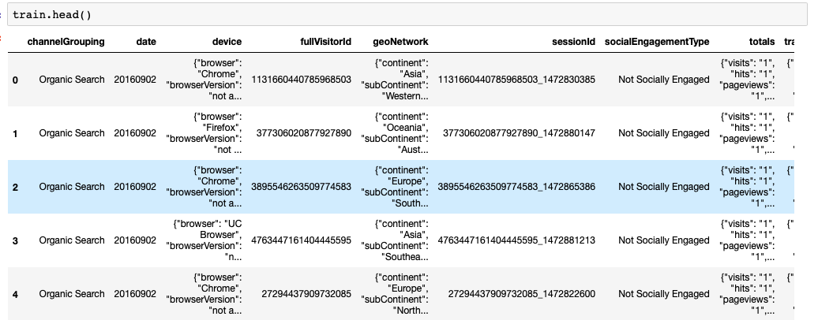
Methodology adopted
2.1 Cleansing
Notes:
After initial review of data I got better understanding of features and what needs to be done for Cleansing.
I
To changeformat of date type to reflect actual parameter for e.g Date -mm/dd/yyyy
Variables with boolean values can be assigned 0 or 1
NaN fields can be replaced with 0 or True or False depending on type of variable
fullvisitorId will be considered as independent variable for this analysis, fullvisitorId will be considered as CustomerId
totals.transactionRevenue will be the target value to be predicted
Certain variables have constant values hence they can removed from this analysis
Certain variables are inclusive datatype for e.g continent -- country -- metro -- city this would allow us to drill down to specific visitorId groups
We will also eliminate the columns that are in train and not in test dataset
Converting data to manageable size
As we can see there are some columns with json format data: . geoNetwork: {"continent": "Asia", "subContinent": "Western...
It makes sense to change the format of the data as we can see it has levels and important characteristic information

Slide 6
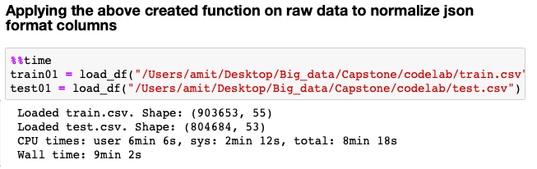
Methodology adopted
2.2 Transformation
Notes:
As we can see the dimension of the dataset has Increased after the use of json_normalize function
We have 55 columns in train and 53 test set.
Credit card fraud detection (http://www.slideshare.net/albahnsen/2014-03-21-acorreabahnsen-edcs-fraud-detection)
http://www.dailymotion.com/video/xdaoae_ibm-commercial-the-road-intelligent_tech

Slide 7
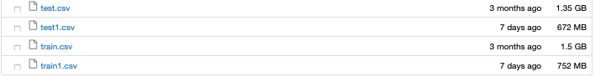
Methodology Adopted
2.3 Size Reduction
Notes:
We not only were able to extract important information from json format columns but also we were able decrease the size of dataset by approximately 50%

Slide 8
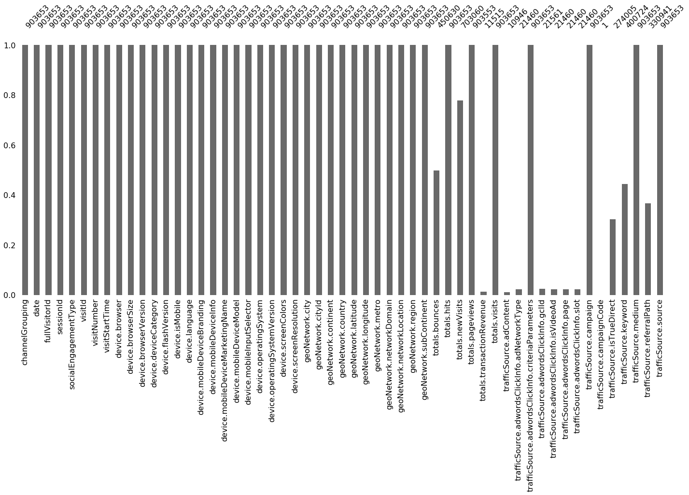
Methodology Adopted
2.5 Missing
Values
Target variable has only 11515 observations
Notes:
A simple yet powerful package called missingno gives you visual and numeric idea of total missing values

Slide 9
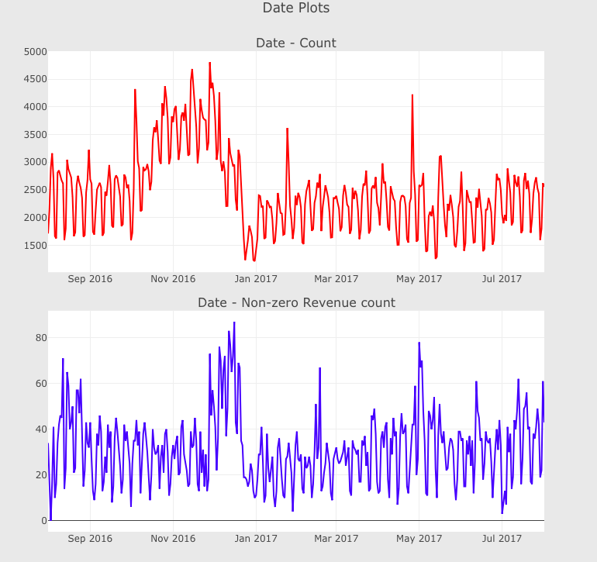
Methodology adopted
3.1 Understanding features (numerical)
Notes:
I created lot of simple plots to check correlation of features with target revenue, here is one such example of what I did.
In this plot I have tried to check importance of time series in our dataset
As we can see in the plot which is on top that visits has increased during month of November and December but in the bottom plot we can see there was high non zero revenue only during end of December
As you can see it was relatively easy to create plots for numerical data type
But categorical data was required to be encoded before plotting or using for modeling

Slide 10
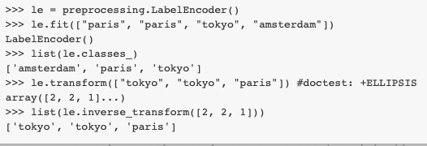
Methodology Adopted
3.2 Understanding features (Categorical)
Notes:
Here is how I encoded it.
This is an example from the python doc help section. And in simpler term it just transforms the string data lets say ‘a’ will be replaced with 0 and aa will be replaced with 1 and so on and so forth
This was vital in developing understanding of the data set and helped in deciding which gradient boosting method to be used.

Slide 11
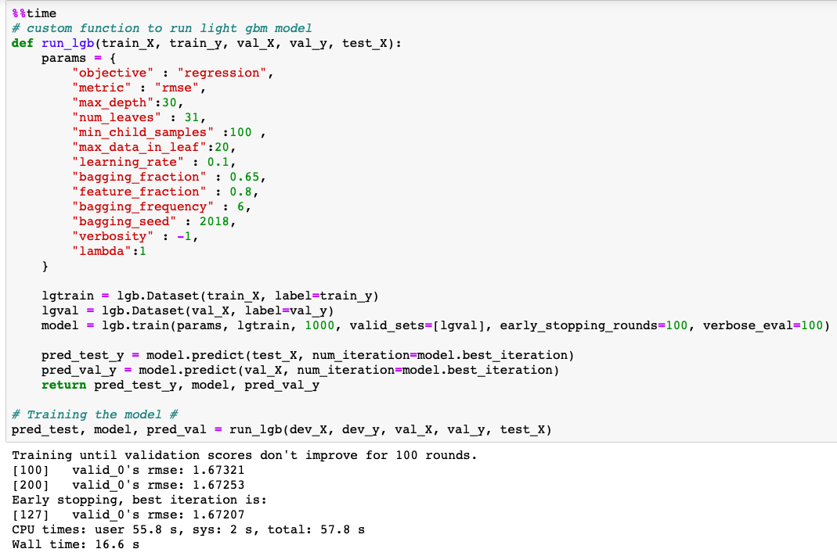
Model Execution
Notes:
I would admit that I don’t consider myself an expert of using lightgbm but here is a brief explanation of logic behind find tuning parameters
Based on my basic understanding of gradient boosting
Objective is kept regression as we know that there is correlation between feature and target value this would allow the model to evaluate correct weights for each parameters
Since the objective of this challenge is to reduce RMSE, we have decided to use RMSE as evaluation metric.
I have kept max_depth: 30 to avoid overfitting
I have kept num_leaves 31 which is default value this served well as we have 37 features
I have kept the max_data_in_leaf at 20 as it is optimum value and it also deals with over fitting
I have kept the min_child_samples to 100 (default is 20) minimum number of data needed in a child (leaf)
I have kept learning rate 0.1 which is default
I have kept bagging fraction:0.65 which specifies the fraction of data to be used for each iteration and it is also useful for boosting speed
I have kept feature fraction: 0.8 so it will take 80 percent of the features in each iteration
I have kept bagging frequency :6 so that it will keep repeat the it 6 times each time working on improving the weak area
Document
https://media.readthedocs.org/pdf/lightgbm/latest/lightgbm.pdf
Blog
https://medium.com/@pushkarmandot/https-medium-com-pushkarmandot-what-is-lightgbm-how-to-implement-it-how-to-fine-tune-the-parameters-60347819b7fc

Slide 12
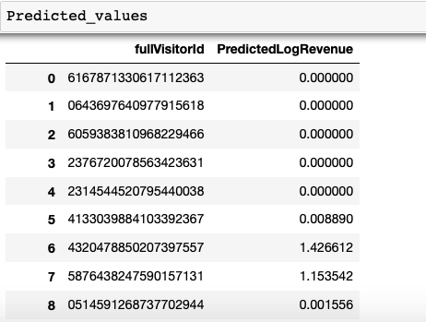
Conclusion
Prediction
Notes:
We are able to successfully predict the customer revenue. With RMSE (root mean squared error) of 1.67
The difference between actual point and predicted point, squared each residuals (difference) cumulative aggregation of all such difference(residuals) then are squared and added then divided by the number of residuals minus one and square root of it all

Slide 13
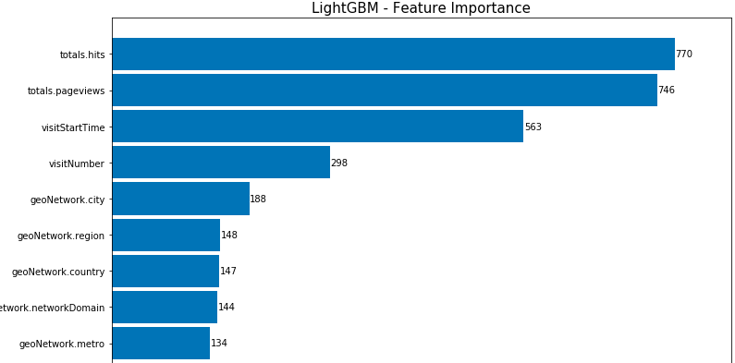
Conclusion Cont.
Notes:
From the above plot we can clearly see that the feature importance: total.hits has highest impact on the target values followed by totals.pageviews and visitStartTime

Slide 14
Tools / Model Used
Notes:
I had several options for executing this project right from the programming language selection to gradient boosting models
I selected python as programming language.
From Gradient boosting methods like xgboost catboost etc xxx I chose Lightgbm because
Boosting: Combines the set of weak learners to form a strong rule through an iterative process. It gives higher importance to the observations that are miss classfied.
Faster training speed and higher efficiency.
Lower memory usage
Better accuracy
Support of parallel and GPU learning.
Capable of handling large-scale data.

Slide 15
References
Json format column transformation
https://www.kaggle.com/julian3833/1-quick-start-read-csv-and-flatten-json-fields/notebook
Lightgbm Logo:
https://techsupportallbugs.wordpress.com/2018/05/26/install-lightgbm-on-mac-osx-10-9/
Document for LightGBM
https://media.readthedocs.org/pdf/lightgbm/latest/lightgbm.pdf
Blog
https://medium.com/@pushkarmandot/https-medium-com-pushkarmandot-what-is-lightgbm-how-to-implement-it-how-to-fine-tune-the-parameters-60347819b7fc
Challenge reference
https://www.kaggle.com/sudalairajkumar/simple-exploration-baseline-ga-customer-revenue

Slide 16
Thank you for your time
The End

